Slide 1
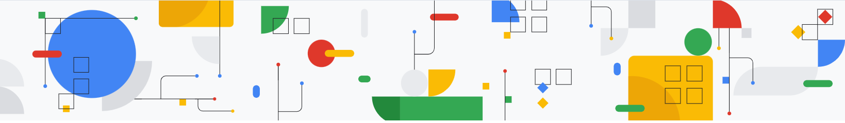
Vector Databases
:- Harsh Dalal

Slide 2
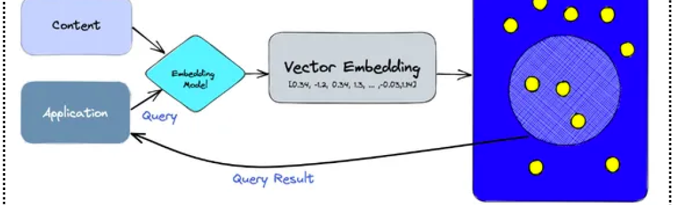
What is a Vector Database
Vector databases store and manage high-dimensional vector representations of data—like text, images, or user behavior—instead of traditional rows and columns. They enable semantic search and similarity-based retrieval, making them essential for AI tasks such as NLP, recommendation systems, and speech recognition, where understanding relationships between data points is key.

Slide 3
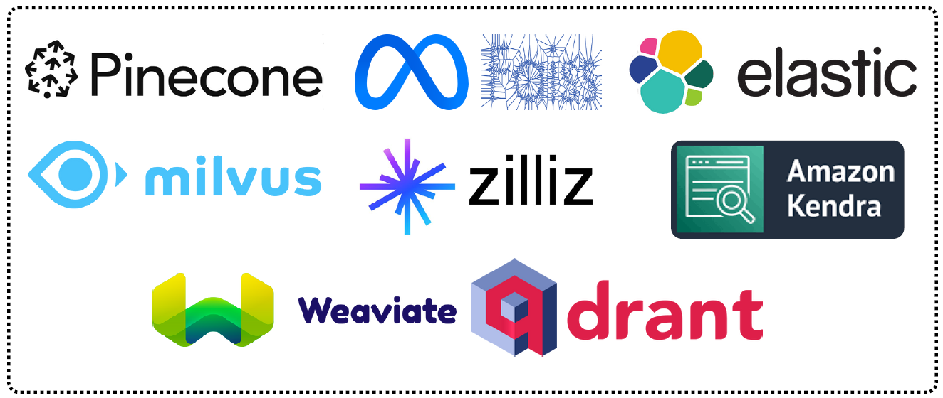
Popular Vector Database Solutions

Slide 4
Chunking in RAG
:- Harsh Dalal

Slide 5
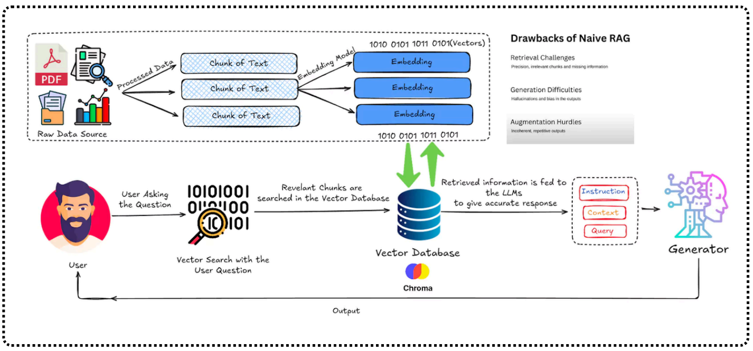
Chunking
Chunking plays a vital role in ensuring that the retrieval step fetches the most relevant information for generation. Poor chunking strategies can lead to:
Loss of Context:
Chunks that are too small may not carry enough information, making retrieval less useful.
Irrelevant Information:
Chunks that are too large may contain unnecessary details, leading to confusion in the generation step.
Inefficient Retrieval:
Badly structured chunks increase retrieval complexity and reduce performance.

Slide 6
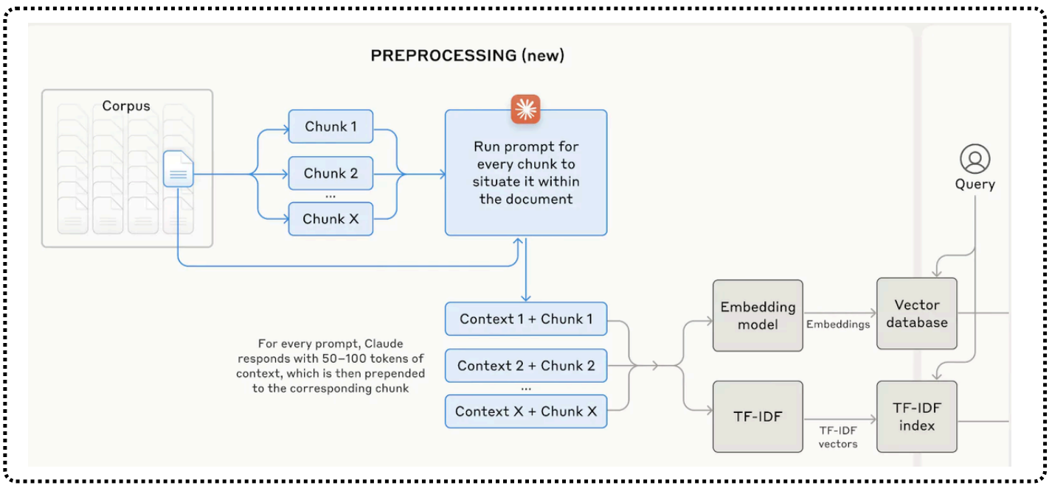

Slide 7

Chunking Strategies
1. Fixed-Length Chunking
This approach divides text into uniform chunks based on a predefined token or word count (e.g., 256 or 512 tokens per chunk).
Pros:
Simple to implement.
Ensures consistent chunk sizes.
Cons:
May cut off meaningful sentences.
Lacks adaptability to different document structures.

Slide 8

Chunking Strategies
2. Semantic Chunking
Semantic chunking is an advanced text-splitting technique that focuses on dividing a document into meaningful chunks based on the actual content and context rather than arbitrary size-based methods such as token count or delimiters.
The primary goal of semantic chunking is to ensure that each chunk contains a single, concise meaning, optimizing it for downstream tasks like embedding into vector representations for machine learning applications.

Slide 9

Chunking Strategies
3. Sliding Window Chunking
A technique where overlapping chunks are created to preserve continuity of information.
For example, if a chunk is 512 tokens, the next chunk may start from the 256th token of the previous chunk.
Pros:
  Maintains context between adjacent chunks.
  Reduces the chance of missing critical information.
Cons:
  Increases storage and computation costs.

Slide 10
Chunking Strategies
4. Hierarchical Chunking
Uses multiple levels of chunking, starting with broader segments (e.g., sections, paragraphs) and then finer chunks within them.
Pros:
  Allows for multi-level retrieval.
  Optimizes information density.
Cons:
  Requires more sophisticated retrieval strategies.

Slide 11
Embeddings
:- Harsh Dalal

Slide 12
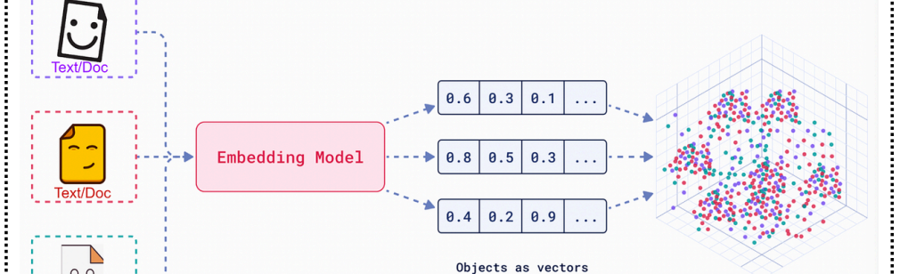
What are Embeddings?
Embeddings are dense vector representations of text that capture semantic meanings, relationships, and contextual nuances. These numerical vectors allow machines to compare, retrieve, and process text efficiently in high-dimensional space.

Slide 13
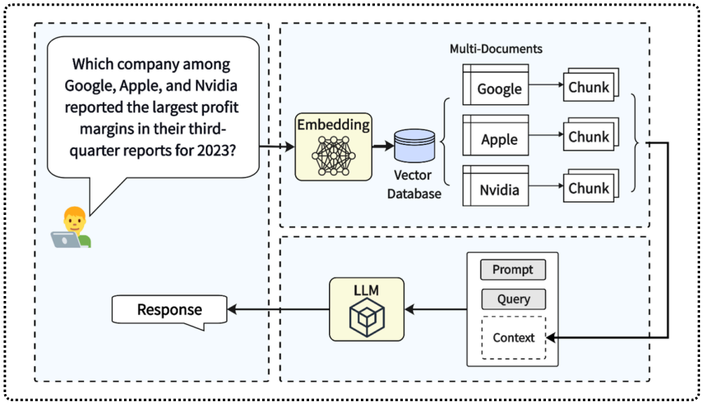
What are Embeddings?
In RAG, embeddings are used to:
Retrieve relevant documents based on query similarity.
Improve response accuracy by feeding relevant data into the generative model.
Enhance contextual understanding by maintaining semantic similarity between queries and retrieved chunks.

Slide 14
Semantic Search Index
:- Harsh Dalal

Slide 15
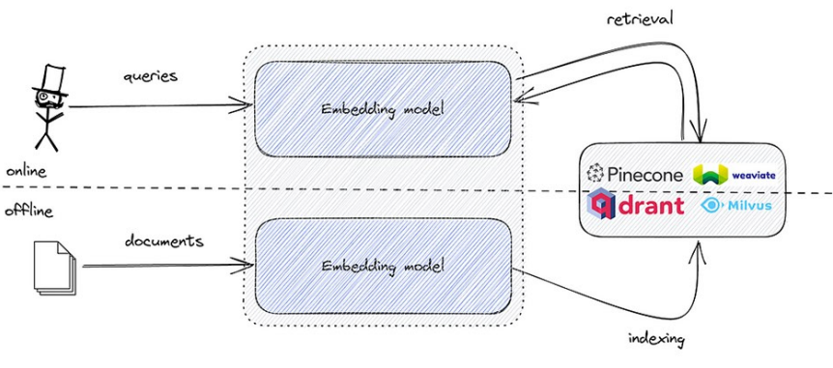
Semantic Search Index
A semantic search index is a specialized data structure used to facilitate semantic search, which focuses on understanding the meaning and intent behind a user's query rather than relying solely on keyword matching. This type of index allows search engines and applications to return more relevant and context-aware results by leveraging natural language processing (NLP), machine learning, and vector-based search techniques.

Slide 16
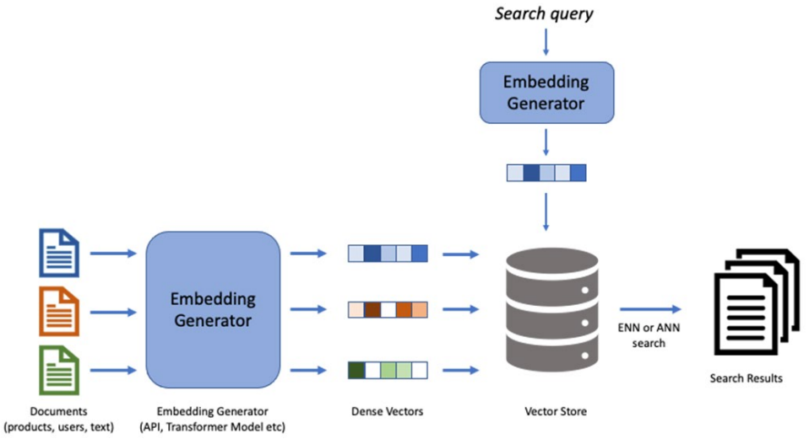
Process of Semantic Search Index

Slide 17
Retrieval Augmented Generation
:- Harsh Dalal

Slide 18
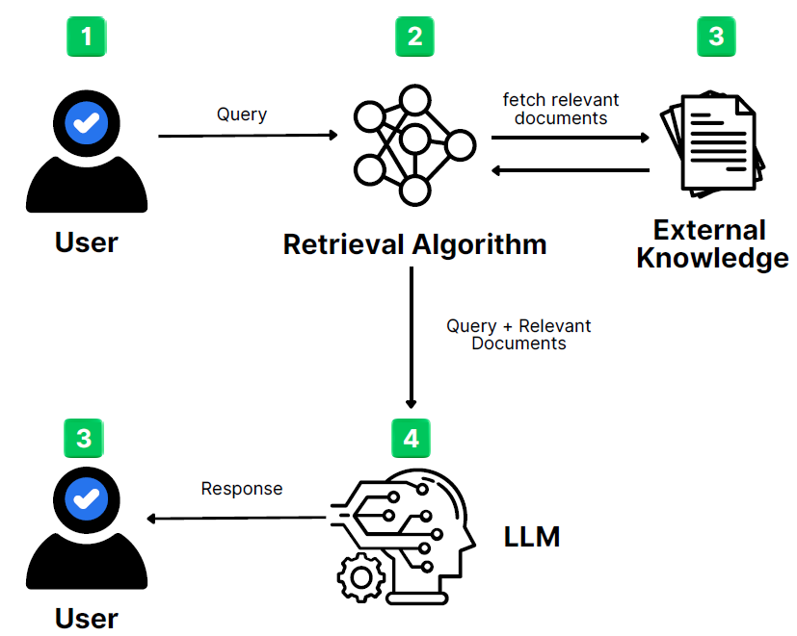
Retrieval Augmented Generation

Slide 19
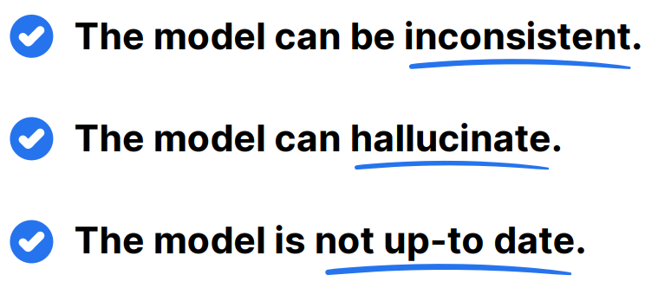
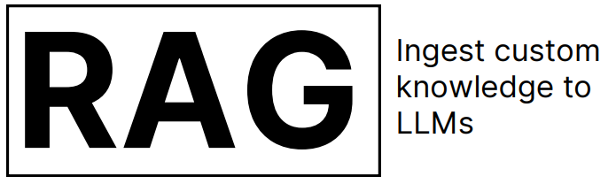
While building LLMs using Prompt Engineering, there are the following problems that occurs:
To overcome all these problems, we use one of popular method to build applications powered by LLMs which is

Slide 20
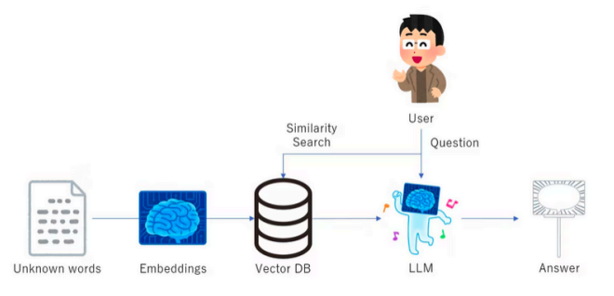
What is RAG
Retrieval-Augmented Generation (RAG) is an innovative approach in natural language processing that combines two primary components: a retrieval mechanism and a generative model.
The retrieval component searches a large database of documents to find relevant information, which the generative model then uses to produce a coherent and contextually appropriate response.

Slide 21
How RAG Differs from LLMs?
Traditional language models (LLMs) generate responses based solely on their training data and the input query.
While they can be remarkably effective, they often struggle with providing up-to-date or specific information not present in their training data.
On the other hand, RAG systems augment their generative capabilities with real-time retrieval of information, ensuring responses are fluent, factually grounded, and relevant.

Slide 22
The Importance of RAG
RAG systems are particularly useful in scenarios where up-to-date and specific information is crucial. Some notable applications include:
  Customer Support: Providing accurate and timely responses to customer queries by retrieving relevant information from a knowledge base.
  Healthcare: Assisting medical professionals with quick access to the latest research and clinical guidelines.
  Education: Offering detailed explanations and additional resources to students based on their queries.

Slide 23
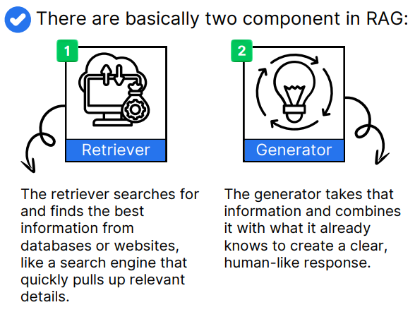
Component of
RAGs

Slide 24

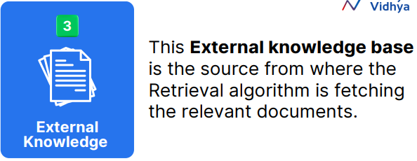
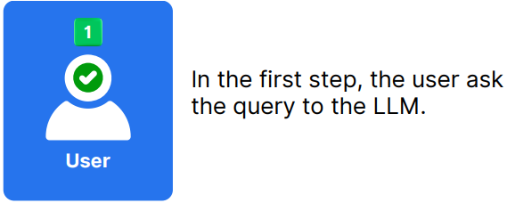
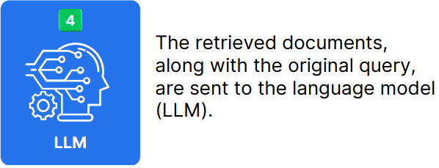
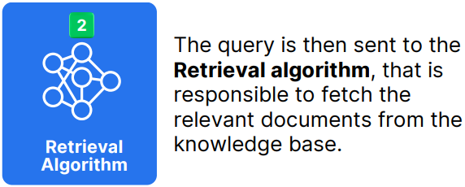
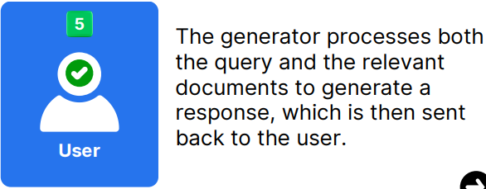
Working of a RAG

